Slide 1
CQRS
IN 4 STEPS

Slide 2
Radek Maziarka
http://radblog.pl/CQRS
objectivity.co.uk
radblog.pl
@RadekMaziarka

Slide 3
CQRS
Command Query Responsibility Segregation

Slide 4
BUILDING BLOCKS
Notes:
The whole presentation is based on my own experience – my projects, my own decisions, my frameworks.

Slide 5
WHY
YOU
SHOULD
EVEN
CARE?

Slide 6
INITIAL STATE

Slide 7
Services
UI
APP
SERVICES
CONTROLLERS

Slide 8
Store application
GetProducts
ChangeProductFieldValue
ProductsController
ProductsService
GetOrder
ChangeOrderDestination
OrdersController
OrdersService

Slide 9
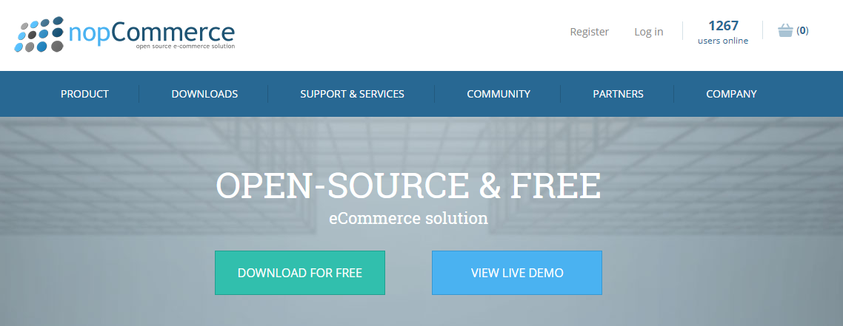
Final state - NopCommerce

Slide 11
Disadvantages of this approach
Enormous controllers / services / helpers
Classes are not following SRP
Refactoring is really difficult
Complexity in writing unit tests

Slide 12
1 COMMAND AND QUERIES

Slide 13
CQRS IS A SIMPLE PATTERN
Two objects for command/queries
where once there was one
JIMMY BOGARD
https://lostechies.com/jimmybogard/2015/05/05/cqrs-with-mediatr-and-automapper/

Slide 14
Read / write services
UI
APP
WRITE
SERVICES
CONTROLLERS
READ
SERVICES

Slide 15
Command / query handlers
UI
APP
Command Handler
Command Handler
Command Handler
Command Handler
CONTROLLERS
Query Handler
Query Handler
Query Handler
Query Handler

Slide 16
Splitting to objects
GetProducts QueryHandler
GetProducts
Query
ProductsController
Mediator
ChangeProduct FieldValue CommandHandler
ChangeProduct FieldValue
Command

Slide 17
MediatR
Simple, umambitious mediator
Simple mediator implementation in .NET
In-process messaging with no dependencies
Request/response, commands, queries, notifications, events
https://github.com/jbogard/MediatR

Slide 18
Splitting to objects
public class ProductsController : ApiController
{
private readonly IMediator mediator;
public ProductsController(IMediator mediator)
{
this.mediator = mediator;
}
[HttpGet]
public IEnumerable<Product> GetProducts(GetProductsQuery query)
{
return this.mediator.Send(query);
}
[HttpPut]
public void ChangeProductFieldValue(ChangeProductFieldValueCommand command)
{
this.mediator.Send(command);
}
}

Slide 19
Query handler
public class GetProductsQueryHandler: IRequestHandler<GetProductsQuery, IEnumerable<Product>>
{
private readonly IProductDatabase _database;
// ctx
public IEnumerable<Product> Handle(GetProductsQuery query)
{
var products = this._database
.Products
.Include(p => p.Category)
.Include(p => p.FieldValues)
.Include(p => p.FieldValues.Select(fv => fv.Field));
// filter products by query values
return products.OrderBy(p => p.CreationDate)
.Skip((query.Page - 1) * query.Take).Take(query.Take)
.ToList();
}
}

Slide 20
Command handler
public class ChangeProductFieldValueCommandHandler
:IRequestHandler<ChangeProductFieldValueCommand>
{
private IProductDatabase database;
private ICategoryFieldService categoryFieldService;
private IProductFieldHelper productFieldHelper;
private IFieldValidatorFactory fieldValidatorFactory;
//ctx
public void Handle(ChangeProductFieldValueCommand command)
{
this._categoryFieldService.ValidateIfFieldCanBeAssignedToProduct
(command.FieldId, command.ProductId);
var fieldValidator = this._fieldValidatorFactory(command.FieldId);
fieldValidator.Validate(command.FieldValue);
// business logic
_database.SaveChanges();
}
}

Slide 21
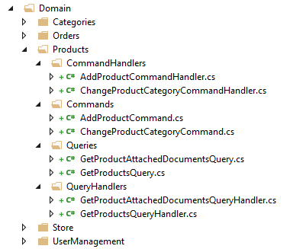
Project structure

Slide 22
Profits after this step
Cleaner structure of application
Lower entry level
Single responsibility + clean code
Clearly defined target and dependencies
Simplicity of writing unit tests

Slide 23
Disadvantages of this step
More difficult than simple controller-database connection

Slide 25
CQRS in the simplest form
UI
APP
Command Handler
Command Handler
Command Handler
Command Handler
CONTROLLERS
Query Handler
Query Handler
Query Handler
Query Handler

Slide 26
CQRS
AS A STEP

Slide 27
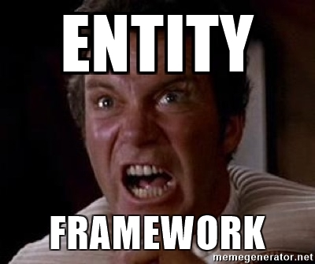
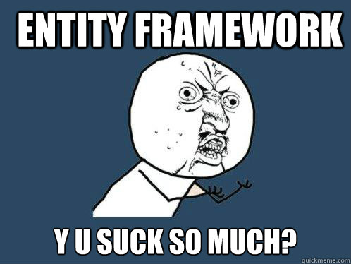

Slide 28
2 DIFFERENT
DATA ACCESS

Slide 29
Different data access
APP
Command Handler
Command Handler
Query Handler
Query Handler
CONTROLLERS
X
Command Handler
Command Handler
Query Handler
Query Handler

Slide 30
Multiple objects
GetProductsQueryHandler
ProductsController
GetProductsFieldsQueryHandler
AddProductCommandHandler
GetCategoriesQueryHandler
GetProductsWithinCategory QueryHandler
CategoriesController
AddCategoryCommandHandler

Slide 31
Objects without change
AddProductCommandHandler
AddCategoryCommandHandler
GetProductsFieldsQueryHandler

Slide 32
Request optimization
GetProductsQueryHandler
X
GetProductsFieldsQueryHandler
AddProductsByBatch
CommandHandler

Slide 33
Plenty of options
Dapper
MicroORM
1
SQL Queries
4
OrmLite
MicroORM
SQL Views
Materialized
2
5
AutoMapper
ProjectTo
EF No tracking
3
6

Slide 34
Profits of using CQRS
Different data access
Ease of experiment
Focus on bottlenecks
No impact on other parts of the system

Slide 36
3 SIMPLE READ MODEL

Slide 37
Simple read model
APP
Command Handler
Command Handler
Query Handler
Query Handler
CONTROLLERS
Query Handler
Query Handler

Slide 38
DDD - Domain events
Core Logic
Event
Side Effect
PlaceOrder
OrderPlaced
SendEmail
http://udidahan.com/2009/06/14/domain-events-salvation/
Notes:
And it fits well in CQRS, and not in service model of work, because you exacly know where to send event – at the finish of CH. With services you have different types and you would sometimes send event, sometimes not.

Slide 39
Domain events in CQRS
Command
Handler
Event
Handler
Mediator
Event
https://docs.microsoft.com/en-us/dotnet/standard/microservices-architecture/microservice-ddd-cqrs-patterns/domain-events-design-implementation
Notes:
And it fits well in CQRS, and not in service model of work, because you exacly know where to send event – at the finish of CH. With services you have different types and you would sometimes send event, sometimes not.

Slide 40
Publish store events
AddProduct
CommandHandler
Mediator
ProductAdded
ChangeProductField
CommandHandler
Mediator
ProductFieldChanged

Slide 41
Create read model
ProductAdded
Product
ReadModel
Handler
ProductFieldChanged
Product
Read
Model
https://docs.microsoft.com/en-us/dotnet/standard/microservices-architecture/microservice-ddd-cqrs-patterns/domain-events-design-implementation#single-transaction-across-aggregates-versus-eventual-consistency-across-aggregates

Slide 42
Transaction per command
Event
Handler
Command
Handler
Event
Handler
Mediator
Event
Event
Handler
Transaction
Behavior
https://github.com/jbogard/MediatR/wiki/Behaviors

Slide 43
Profits of using CQRS
Simple read model
Ease of creating read model
Domain events straightly connected to command handlers
No data loss

Slide 44
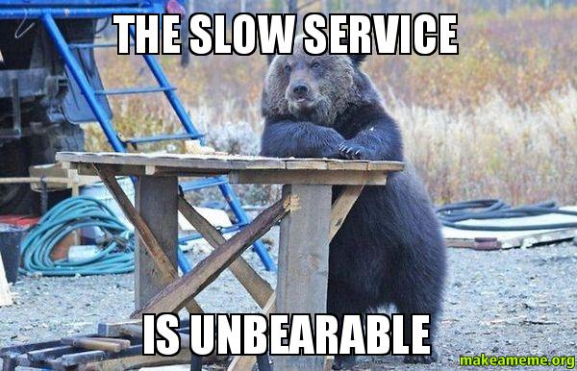

Slide 45
4 ASYNCHRONOUS READ MODEL

Slide 46
Asynchronous read model
APP
Command Handler
Command Handler
Query Handler
Query Handler
CONTROLLERS
Query Handler
Query Handler

Slide 47
Event bus
Event Bus
ProductAdded
Product
ReadModel
Handler
ProductFieldChanged
https://docs.microsoft.com/en-us/dotnet/standard/microservices-architecture/multi-container-microservice-net-applications/integration-event-based-microservice-communications
BUS

Slide 48
Different databases
Event Bus
Product
SearchModel
Handler
Product
CacheModel
Handler
BUS

Slide 49
Notify the user
Event Bus
Product
SearchModel
Handler
ProductsHub
SignalR
http://danielwhittaker.me/2014/10/27/4-ways-handle-eventual-consistency-ui/
BUS

Slide 50
Profits of using CQRS
Asynchronous read model
Database focused on problem
Non-blockable commands
Designed for scale

Slide 51
Disadvantages of using CQRS
Asynchronous read model
Distributed system
Eventual consistency
Operational complexity

Slide 52
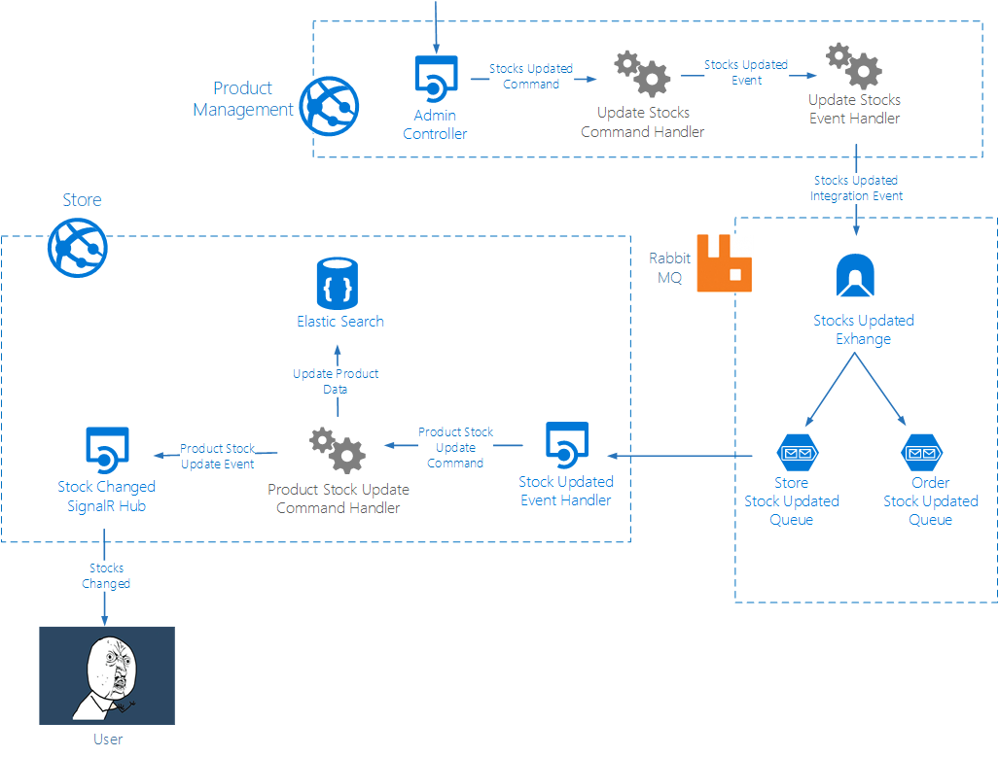

Slide 55
CQRS
in 4 steps
1
2
3
4
COMMAND AND QUERIES
DIFFERENT DATA ACCESS
SIMPLE
READ MODEL
ASYNCHRONOUS
READ MODEL

Slide 56
http://radblog.pl/CQRS
CQRS implementation + MediatR:
Jimmy Bogard - CQRS with MediatR and AutoMapper - https://lostechies.com/jimmybogard/2016/10/27/cqrsmediatr-implementation-patterns/
Jimmy Bogard - CQRS/MediatR implementation patterns https://lostechies.com/jimmybogard/2015/05/05/cqrs-with-mediatr-and-automapper/
CQRS implementation:
Maciek Aniserowicza - CQRS pragmatycznie - https://kupdf.com/download/maciej-aniserowicz-cqrs-pragmatycznie_597c9425dc0d60997f2bb17f_pdf
Future Processing - CQRS Simple Architecture - https://www.future-processing.pl/blog/cqrs-simple-architecture/
Derek Comartin - Fat Controllers CQRS Diet - https://codeopinion.com/fat-controller-cqrs-diet-notifications
Radek Maziarka - First step - Split to commands and queries http://radblog.pl/2017/08/19/cqrs-first-step-split-to-commands-and-queries/
More generic about CQRS:
Greg Young - CQRS Documencts - https://cqrs.files.wordpress.com/2010/11/cqrs_documents.pdf
Greg Young - CQRS and Event Sourcing - https://www.youtube.com/watch?v=JHGkaShoyNs
Microsoft - CQRS Journey - https://msdn.microsoft.com/en-us/library/jj554200.aspx
Udi Dahan - Clarified CQRS - http://udidahan.com/2009/12/09/clarified-cqrs/
CQRS in Node.js https://medium.com/@domagojk/patterns-for-designing-flexible-architecture-in-node-js-cqrs-es-onion-7eb10bbefe17
Herberto Graca - From CQS to CQRS - https://herbertograca.com/2017/10/19/from-cqs-to-cqrs/
Radek Maziarka - CQRS in 4 steps - http://radblog.pl/2017/09/17/cqrs-in-4-steps-lightning-talk/
CQRS in polish:
Bulldog - CQRS i Event Sourcing - https://bulldogjob.pl/articles/122-cqrs-i-event-sourcing-czyli-latwa-droga-do-skalowalnosci-naszych-systemow_
it-consulting - CQRS - http://it-consulting.pl/autoinstalator/wordpress/2012/10/18/cqrs-czyli-kto-co-i-jak-zamawia-i-dostarcza/
Łukasz Szydło - P&A + DDD + CQRS = 00 - https://www.youtube.com/watch?v=yhYFL4ujYqY

Slide 57
http://radblog.pl/CQRS

